Slide 1
Pookas ETventure
Virtual Classroom with Edventure

Slide 2
Pookas’ Members
Ivan Loh – Project Manager
Sarah Lam – QA
Gillian Ng – System Architect
Lui Quan Fu – Lead Developer
Goh Li-Xian – Developer

Slide 3
Virtual Classroom with Edventure
Best learning platform for Students in Activeworld
Automated Lessons and games
Virtual Meeting place for friends
Upgraded and improved functions over previous group

Slide 4

We Attained CMM Level 2

Slide 5

Now, we are CMM Level 3 Company!
Notes:
I think we have integrated software management. Integrated software management is: "Commitment to perform
Commitment 1 -- The project follows a written organizational policy requiring that the software project be planned and managed using the organization's standard software process and related process assets."
I think that all our software follows the design->implementation->testing process, and documenting everything throughout, we could say that I guess? Check the CMM document from Lab 2. Organizational process definition could maybe be like, configuration management process or something? Like we standardize using SVN in ALL our development processes? And Mantis etc. And the kinds of documents needed for each stage of the development cycle will be standardized. Organization process focus just means we follow what we said we would do, to a good standard.

Slide 6
Wow! Functions
Student Bot for All-day chatting
Lecturer Bot for Announcements & chatting about course-related information
Real time announcements retrieved from Edventure.sg
Lecture Video streamed directly from Eventure.sg

Slide 7
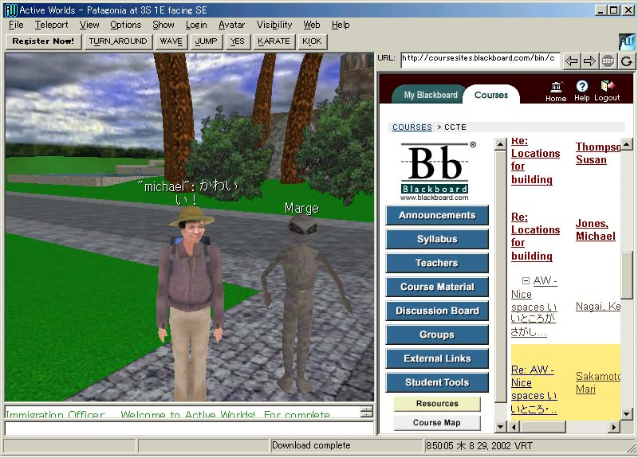
More Wow! Functions
No more using Active-world Web Browser
Powerpoint displayed directly inside 3D game world
Powerpoint retrieved from Edventure.sg
Real Time Game Quiz with fellow users
Active Scoring System
Multiple users able to join game quiz
Choose answer by running to grid box
Quiz questions retrieved from remote server to simulate retrieval from Edventure.sg
Teleport to different areas in the world

Slide 8
Proper Project Management
Regular Meeting chaired by Project Manager
Meetings are documented in meeting minutes
Use of SVN to manage changes
Use of bugs tracking software to track all bugs issues
4 x Code Reviews
1 x Peer Review
Training provided
Team member skilled in certain areas trained other team members

Slide 9
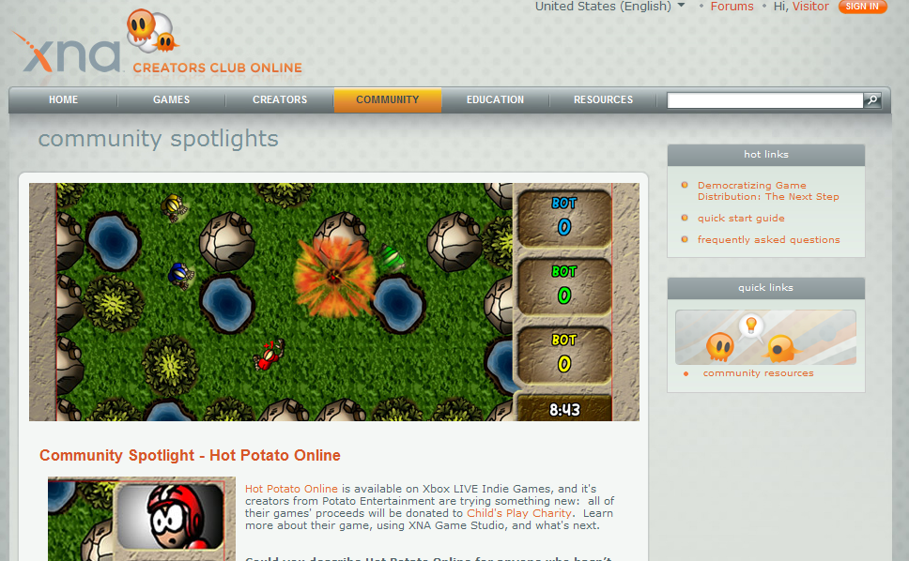
Tools Used In Industry
http://creators.xna.com/en-US/spotlight/hotpotatoonline
What other tools/programs do you use to help you make your games? “…. Tortoise SVN was our version control tool, Mantis was used for bug and task tracking ….” -- Adam and Perusse, 2009

Slide 10
Proper Documentations
Full Project Plan
Requirements Specifications
Design Specifications
Team & Personal Software Process log (TSP/PSP)
Software Quality Assurance Plan
Software Configuration Management Plan
Peer Review Policy
Test Plan
Bugs Issue Report
Change Revisions Report

Slide 11
Many Diagrams Produced
The Team spent countless hours to model all the requirements, design, testing etc.
Class Diagrams
Use Cases
Activity Diagrams
Activity Dependency Chart
State Diagram
Finite State Machine Diagram
Transition Trees

Slide 12
Testing

Slide 13
Manuals
Full instruction manuals on how to use the various functions
Manuals includes screenshots for easy reference
Video review of all the new functions
Good and precise Code documentations

Slide 14
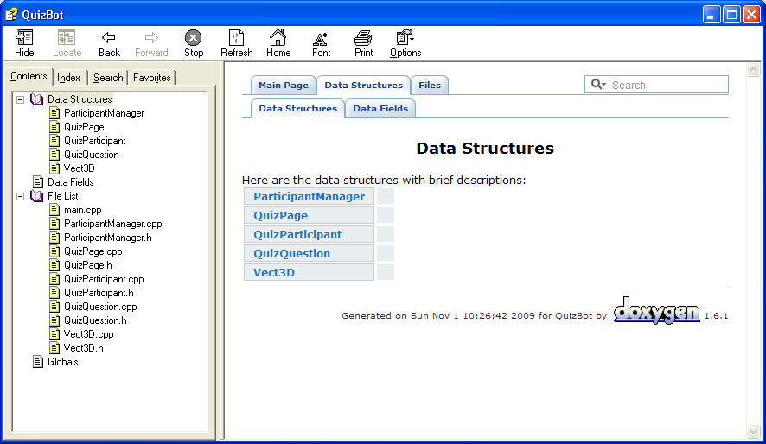
QuizBot Manual

Slide 15
Demo
We will now demo the Active World

Slide 16
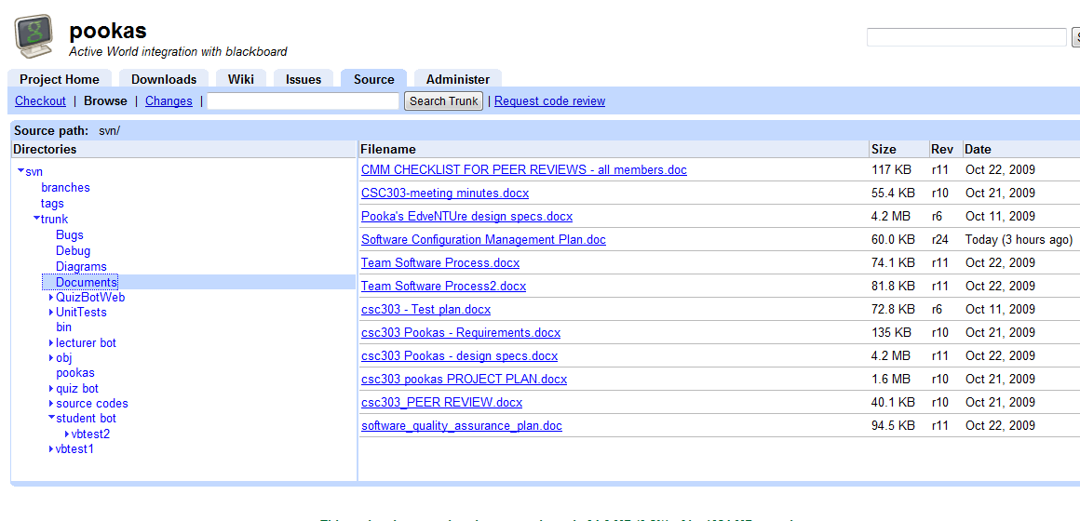
Pookas’ SVN

Slide 17
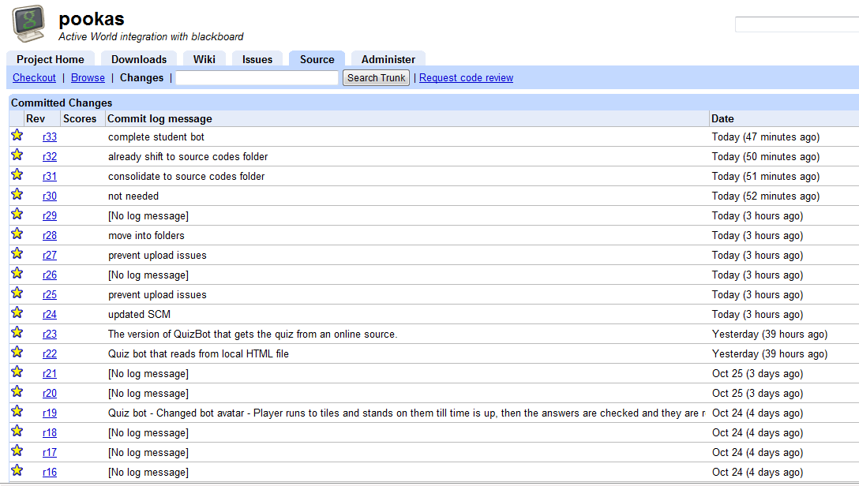
Change Revision Report

Slide 18
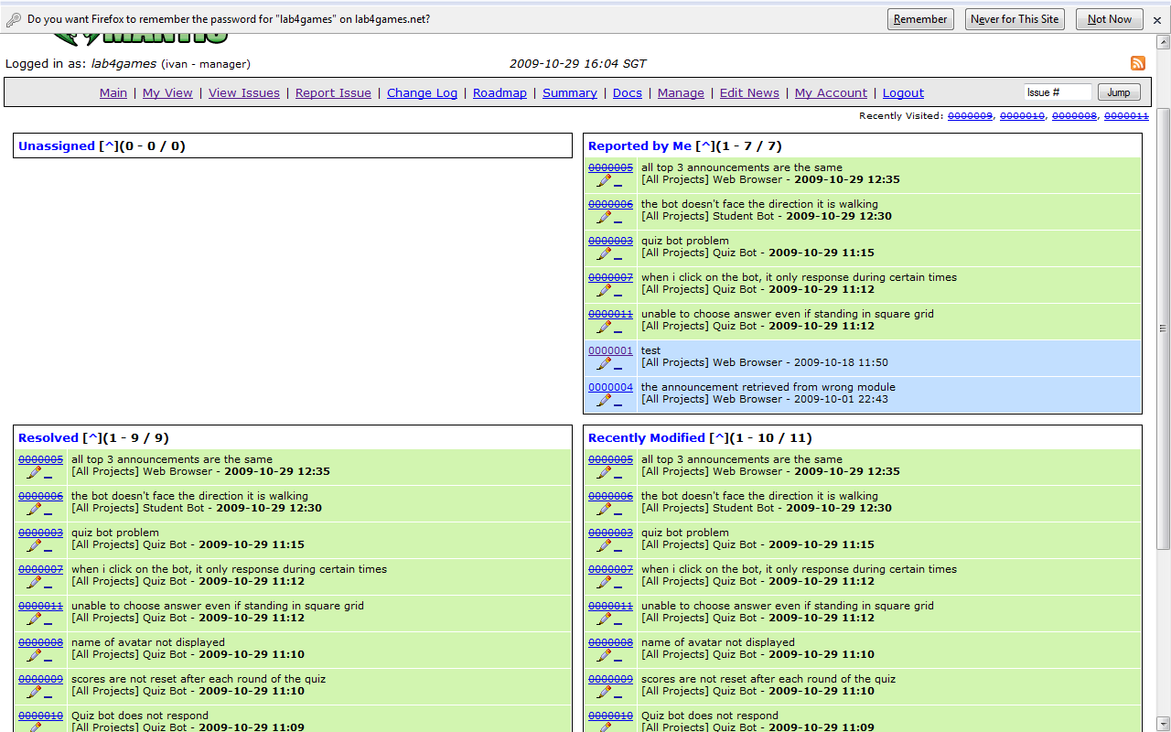
Mantis Bug Tracker

